Slide 1
Java 8 Features

Slide 2
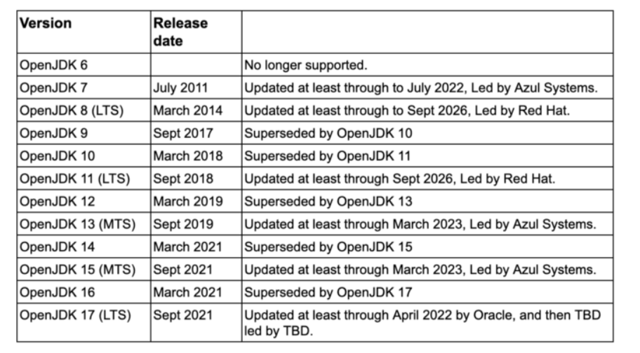

Slide 3
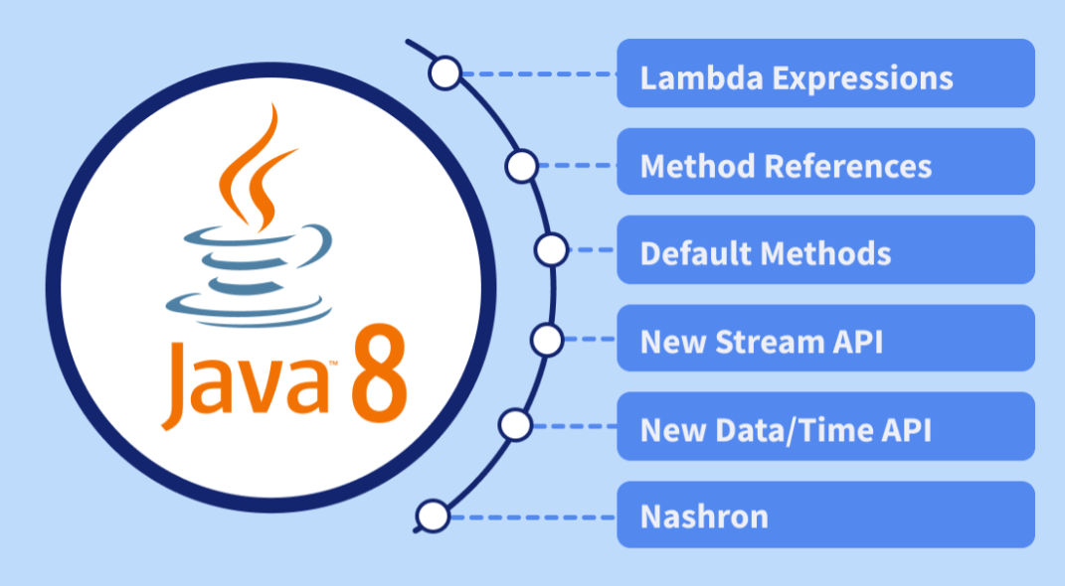
Key Features of Java 8

Slide 4
Lambda Expressions
lambda expression is an anonymous function.
A function that doesn’t have a name and doesn’t belong to any class.
Java Lambda Expression Syntax
To create a lambda expression, we specify input parameters on the left side of the lambda operator ->, and place the expression or block of statements on the right side of lambda operator.
The basic syntax of a lambda expression is:
either
(parameters) -> expression
or
(parameters) -> { statements; }
or
() -> expression

Slide 5
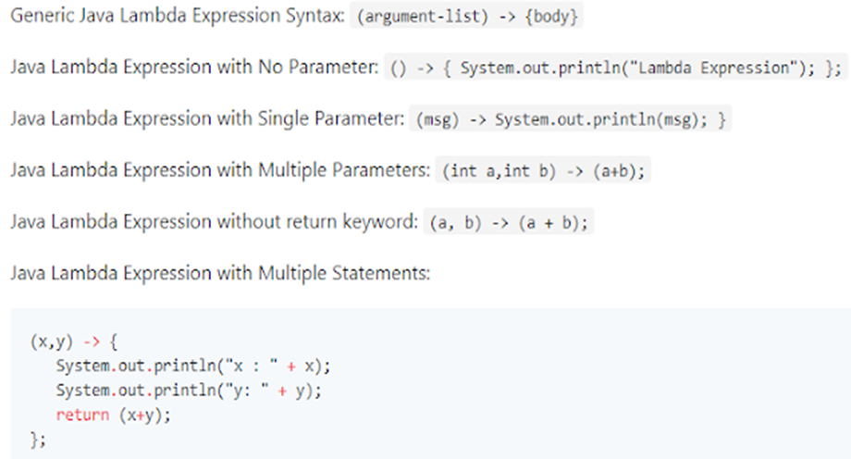

Slide 6
Advantages of Lambda Expressions
Less Boilerplate Code: Reduces the verbosity of anonymous classes.
Improved Readability: Code becomes cleaner and easier to understand.
Supports Functional Programming: Facilitates declarative and functional styles of coding.
Enhanced API Usage: Works seamlessly with the Streams API.
https://medium.com/@ucgorai/java-8-features-that-every-programmer-must-know-39e73a1daafb

Slide 7
Method References
Method reference is a shorthand notation of a lambda expression to call a method.
If your lambda expression is like this:
str -> System.out.println(str)
then you can replace it with a method reference like this:
System.out::println
The :: operator is used in method reference to separate the class or object from the method name
Four types of method references
1. Method reference to an instance method of an object – object::instanceMethod 2. Method reference to a static method of a class – Class::staticMethod 3. Method reference to an instance method of an arbitrary object of a particular type – Class::instanceMethod 4. Method reference to a constructor – Class::new

Slide 8
Java Functional Interfaces
An interface with only single abstract method is called functional interface.
You can either use the predefined functional interface provided by Java or create your own functional interface and use it.
To use lambda expression in Java, you need to either create your own functional interface or use the pre defined functional interface provided by Java.
While creating your own functional interface, mark it with @FunctionalInterface annotation.
What are the rules of defining a functional interface?
The functional interface should have Only one abstract method. Along with the one abstract method, they can have any number of default and static methods.

Slide 9
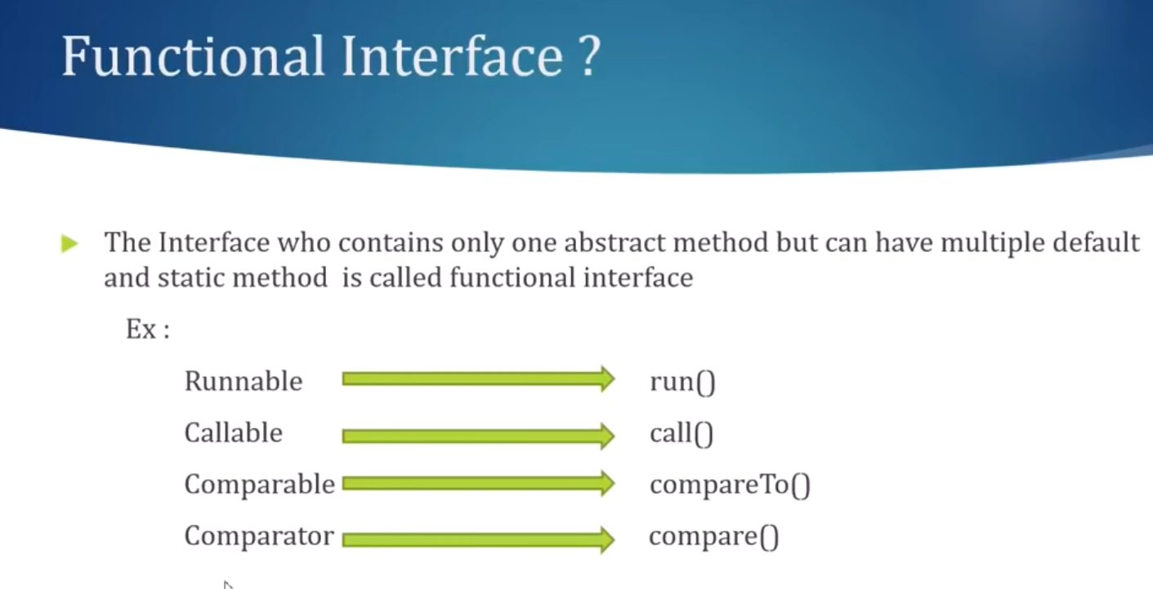

Slide 10
Interface Changes – default method and static method
In interface in java can only have abstract methods.
All the methods of interfaces are public & abstract by default.
Java 8 allows the interfaces to have default and static methods.
The reason we have default methods in interfaces is to allow the developers to add new methods to the interfaces without affecting the classes that implements these interfaces.
Static methods in interfaces are similar to the default methods except that we cannot override these methods in the classes that implements these interfaces.

Slide 11
What is Stream
Stream represents a sequence of elements from a source, which supports aggregate operations.
Source − Stream takes Collections, Arrays, or I/O resources as input source.
Aggregate operations − Stream supports aggregate operations like filter, map, limit, reduce, find, match, and so on.
Pipelining − Most of the stream operations return stream itself so that their result can be pipelined. These operations are called intermediate operations and their function is to take input, process them, and return output to the target.
A terminal operation which is normally present at the end of the pipelining operation to mark the end of the stream.

Slide 12
How to work with Stream in Java
Stream can be explained in three stages:
1. Create a stream
2. Perform intermediate operations on the initial stream to transform it into another stream and so on further intermediate operations.
3. Perform terminal operation on the final stream to get the result.

Slide 13
As source we can have collections, arrays, lines of a file, files in a directory or numeric ranges;
Intermediate operations are filter, map, distict or flatMap etc.. several intermediate operations can be concatenated.
Terminal operations are for example forEach, collect, reduce, min max, etc…
Only one terminal operation is possible, if a terminal operation is executed the stream will be closed and cannot be used again.

Slide 14
The filter() is an intermediate operation that reads the data from a stream and returns a new stream after transforming the data based on the given condition.

Slide 17
https://www.youtube.com/watch?v=ltHm_RA53sI

Slide 18
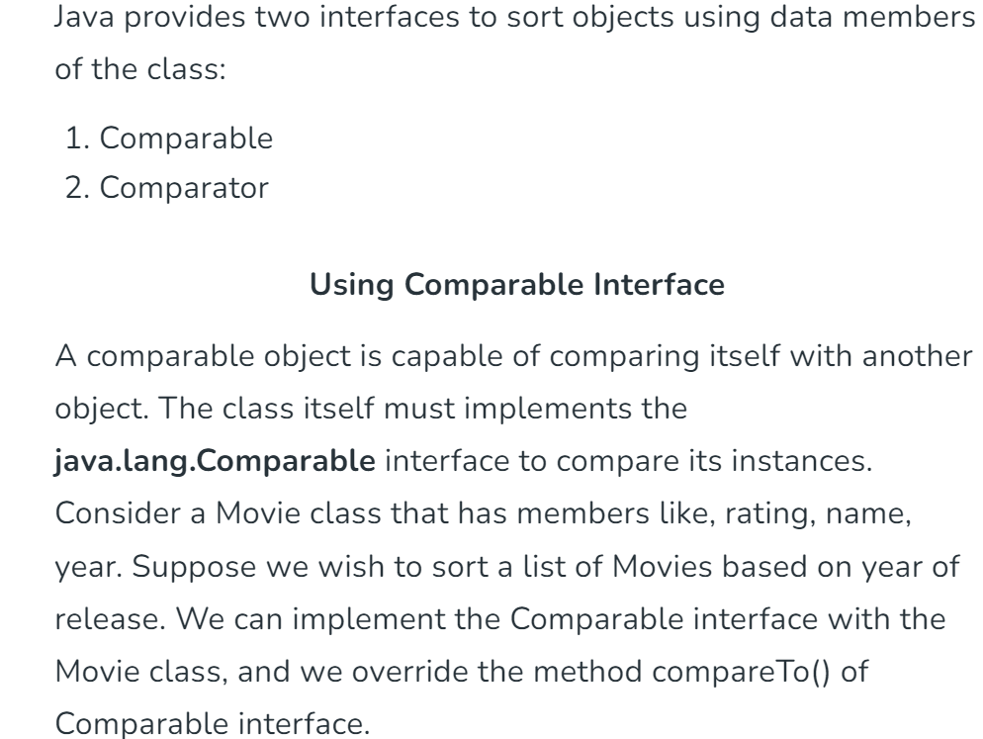
Comparable vs Comparator in Java

Slide 19
Using Comparator
Unlike Comparable, Comparator is external to the element type we are comparing. It’s a separate class. We create multiple separate classes (that implement Comparator) to compare by different members.
Collections class has a second sort() method and it takes Comparator. The sort() method invokes the compare() to sort objects.

Slide 20
https://www.youtube.com/playlist?list=PLb9rJN26yMEmlAzQKabssjXzV7s5uSPXE
Interview questions

Slide 21
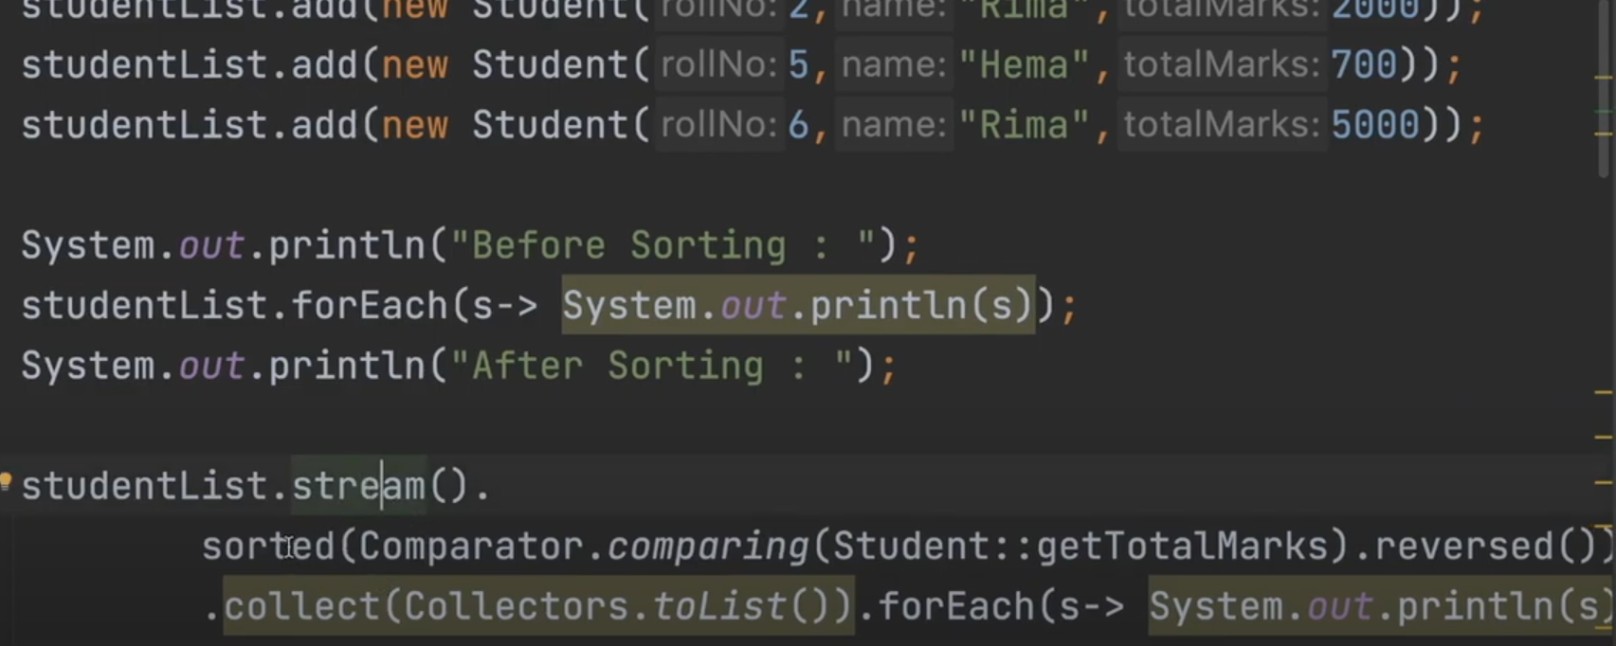

Slide 22
